Slide 1
REAL TIME PCR
Source- C:\Users\admin\Documents\Ritu\Real-Time PCR\Real Time PCR Tutorial.mht

Slide 2
PCR- Recap
Real-time PCR (machine and detection)
Detection Ways
SyBr Green
Taqman Probe
Molecular Beacons
PCR vs Real-Time PCR
Reading the Graphs
X and Y axis
Threshold and Ct value
Melting Temperature
Controls, Normalization Controls, Efficiency and Slope
Quantification- Absolute and Relative Quantification
Precautions
Uses

Slide 3
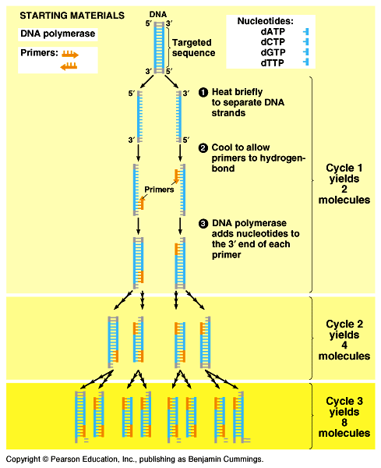
Copy DNA without plasmids? PCR!
Polymerase Chain Reaction
Rapid procedure for in vitro enzymatic amplification of a specific segment of DNA
It takes place in three steps:
Denaturation at 94C
Annealing of Primers at 50-65C
Extension by DNA polymerase at 72C
A total of 25-40 cycles.
Notes:
3
T.aquaticus is a bacterium that lives in hot springs and hydrothermal vents, and Taq polymerase was identified as an enzyme able to withstand the protein-denaturing conditions (high temperature) required during PCR. It replaced the DNA polymerase from E.coli originally used in PCR . Taq's optimum temperature for activity is 75-80°C, with a halflife of 9 minutes at 97.5°C, and can replicate a 1000 base pair strand of DNA in less than 10 seconds at 72°C.

Slide 4
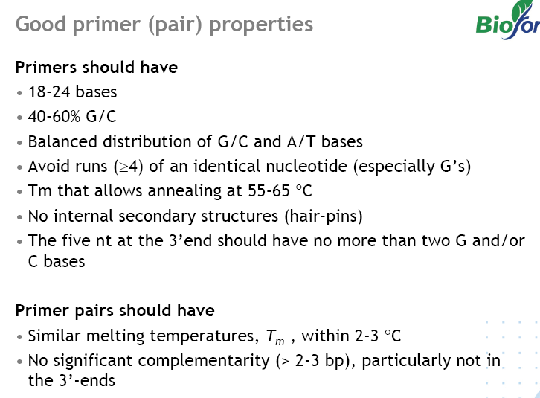

Slide 5
Reverse transcription polymerase chain reaction- RT-PCR
Reverse transcription polymerase chain reaction (RT-PCR) is a variant of polymerase chain reaction (PCR), commonly used in molecular biology to generate many copies of a DNA sequence, a process termed "amplification". In RT-PCR, however, RNA strand is first reverse transcribed into its DNA complement using the enzyme reverse transcriptase, and the resulting cDNA is amplified using traditional or real-time PCR..

Slide 6
Consideration while designing primers for detection of a transcript
EXON 1
INTRON 2
EXON 2
DNA
EXON 1
EXON 2
RNA
EXON 1
EXON 2
RNA
Utilize the differences in the DNA and RNA (lack of introns)
Design primers spanning the intron-exon boundary

Slide 7
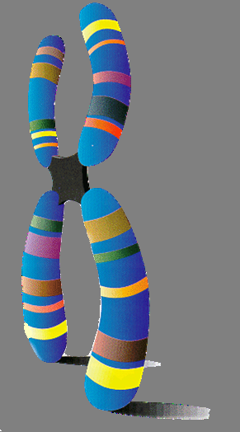
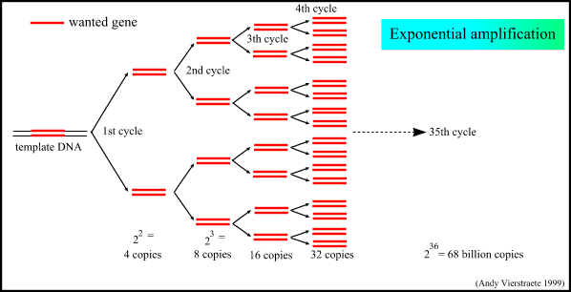
Amplification
It has an exponential increase in the number of target DNA fragments
30 cycles = 2³⁰ copies
Y= A x 2^{n}
A= initial number of copies of target DNA
N= number of cycles
Y number of copies of DNA after the reaction
Amount of DNA
Time

Slide 8
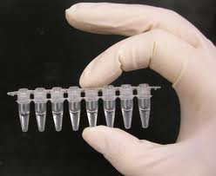
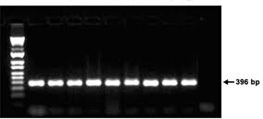
PCR AMPLIFICATION
End-point Detection
Notes:
Advantages of PCR-
Direct cloning from genomic DNA or cDNA
Genetic fingerprinting of forensic samples (can amplify from small trace of sample)
In vitro mutagenesis and genetic engineering
Assays for the presence of infectious agents (HIV, mycobacterium)
Prenatal diagnosis of genetic diseases
Analysis of allelic sequence variations
Direct nucleotide sequencing of genomic and cDNA

Slide 9
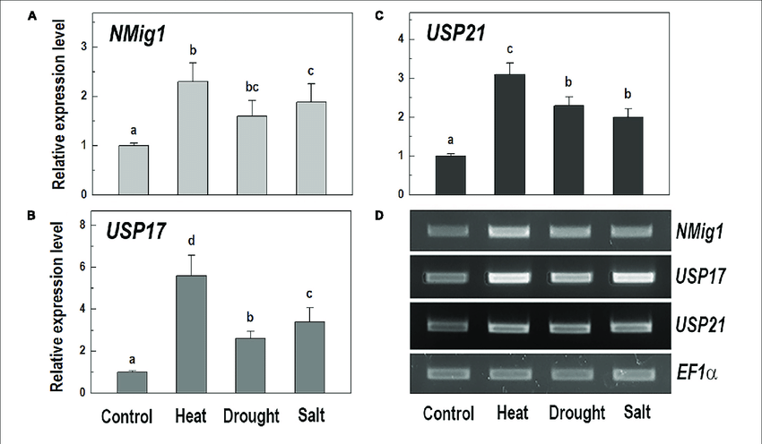

Slide 10
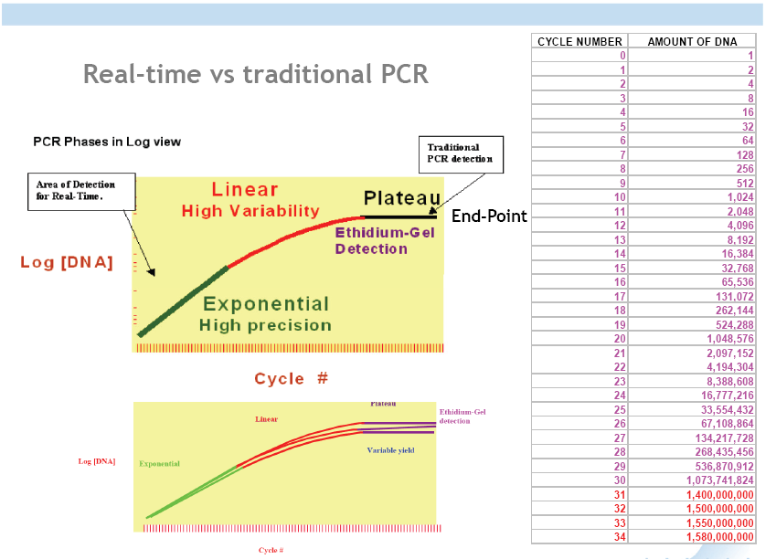

Slide 11
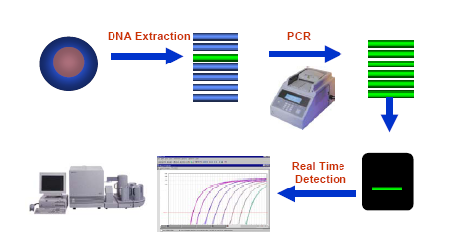
EVOLUTION OF REAL-TIME PCR

Slide 12
Real-time polymerase chain reaction
Real-time polymerase chain reaction, also called quantitative real time polymerase chain reaction (Q-PCR/qPCR) is a laboratory technique based on the polymerase chain reaction, which is used to amplify and simultaneously quantify a targeted DNA molecule. It enables both detection and quantification (as absolute number of copies or relative amount when normalized to DNA input or additional normalizing genes) of a specific sequence in a DNA sample.

Slide 13
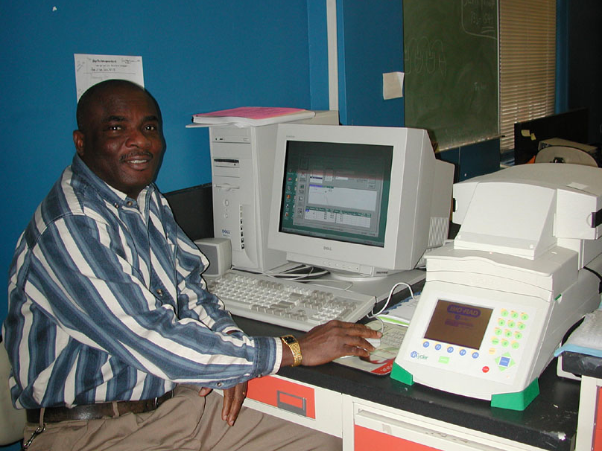
Real-time machine is connected to a computer with software to run real-time PCR machine
Notes:
The real-time machine is connected to a computer and software on the computer is needed to run the real time PCR machine in real-time mode.

Slide 14
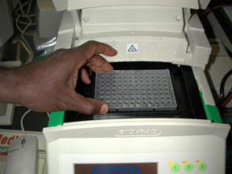
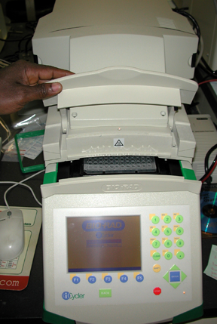
LOADING SAMPLES IN REAL-TIME PCR MACHINE

Slide 15
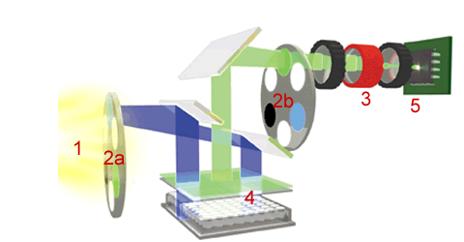
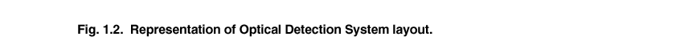
3. intensifier
5. ccd detector 350,000 pixels
1. halogen tungsten lamp
2b. emission filters
2a. excitation filters
4. sample plate
www.biorad.com

Slide 16
METHODS OF DETECTION
All real time PCR systems rely upon the detection and quantification of fluorescent reporter, the signal of which increases in direct proportion of the amount of PCR product in a reaction.
Two common methods of quantification
use of fluorescent dyes that intercalate with double-stranded DNA.
modified DNA oligonucleotide probes that fluoresce when hybridized with a complementary DNA.

Slide 17
USING FLUORESCENT DYES
The reaction is prepared as usual, with the addition of fluorescent dsDNA dye like SYBR GREEN.
The reaction is run in a thermocycler, and after each cycle, the levels of fluorescence are measured with a detector; the dye only fluoresces when bound to the dsDNA.
The resulting DNA-dye-complex best absorbs 497 nanometer blue light (λ_{max} = 497 nm) and emits green light (λ_{max} = 520 nm).
Notes:
SYBR Green I is a dye that binds to the minor groove of double-stranded DNA (dsDNA) in a sequence-independent way, emitting 1000-fold greater fluorescence than when unbound (Wittwer et al., 1997).

Slide 18
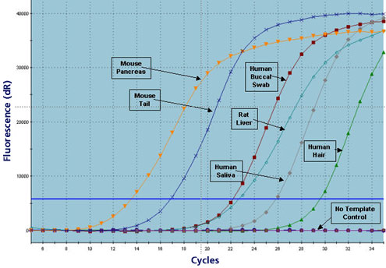
How SYBR Green dye works
Sybr green is a dye which binds to double stranded DNA but not to single-stranded DNA
SYBR green binds to double stranded DNA and upon excitation emits light at 520nm
Thus as PCR product accumulates the fluorescence increases

Slide 19
Typical Real-Time PCR cycle
1. 95 C- 10 min
2. 95- 30 sec
3. 60- 30 sec
4. 72-30 sec
5. Read
6. Go to step 2 for 39 more cycles
7. The melt curve protocol follows with 30 seconds at 95°C and then cooling to Anneaing temp (60C) for 30 sec. and then10 seconds each at 0.2°C increments between 60°C and 95°C. Data collection is enabled at each increment of the melt curve.

Slide 20
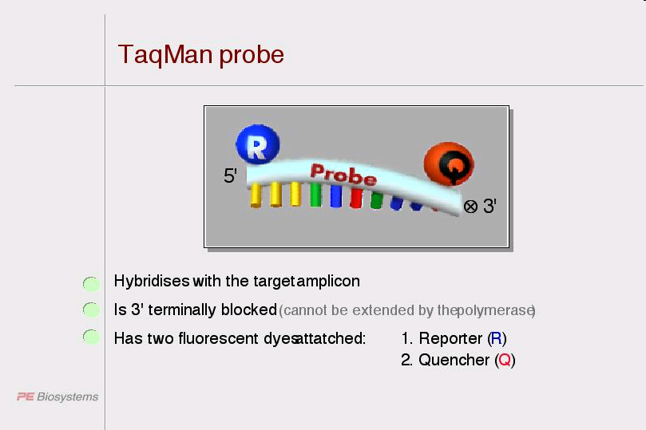
Other Emerging Alternatives
Two most popular alternatives to SYBR green are TaqMan® and Molecular Beacons.
Both technologies depend on hybridization probes.
Notes:
https://www.youtube.com/watch?v=ob3teCrpgxY
https://www.youtube.com/watch?v=YhXj5Yy4ksQ

Slide 21
USING PROBES
The PCR reaction is prepared as usual and the reporter probe is added.
both probe and primers anneal to the DNA target.
once the polymerase reaches the probe, its 5'-3-exonuclease degrades the probe, physically separating the fluorescent reporter from the quencher, resulting in an increase in fluorescence.
Fluorescence is detected and measured in the real time PCR thermocycler

Slide 22
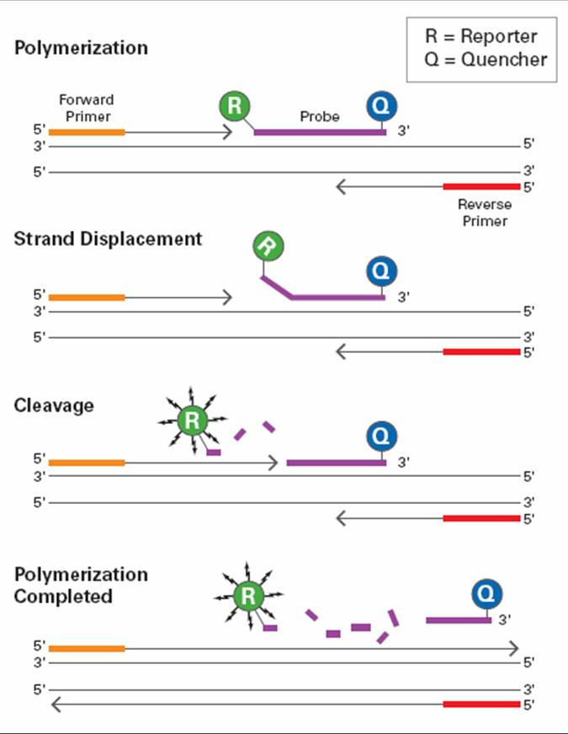
Taqman Probes
Notes:
One commonly used fluorescent reporterquencher pair is fluorescein (FAM, which emits green fluorescence) and Black Hole Quencher 1.
Black Hole Quenchers are capable of quenching across the entire visible spectrum.

Slide 23
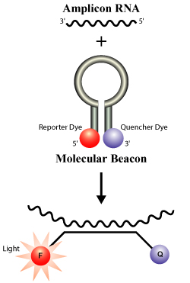
Molecular Beacons
Molecular beacons are short segments of single-stranded DNA .
They are designed to adopt a hairpin structure while free in solution, bringing the fluorescent dye and quencher in close proximity. When a molecular beacon hybridizes to a target the fluorescent dye emits light upon irradiation, and rebind to target in every cycle for signal measurement.
Notes:
Unlike TaqMan assays, molecular beacons are displaced but not destroyed during amplification, because a DNA polymerase lacking the 5' exonuclease activity is used.
They are highly specific, can be used for multiplexing, and if the target sequence does not match the beacon sequence exactly, hybridization and fluorescence will not occur —a desirable quality for allelic discrimination experiments.
The main disadvantage of using molecular beacons lies in their design. The stem of the hairpin must be strong enough that the molecule will not spontaneously fold into non-hairpin conformations that result in unintended fluorescence. At the same time, the stem of the hairpin must not be too strong, or the beacon may not properly hybridize to the target.

Slide 24
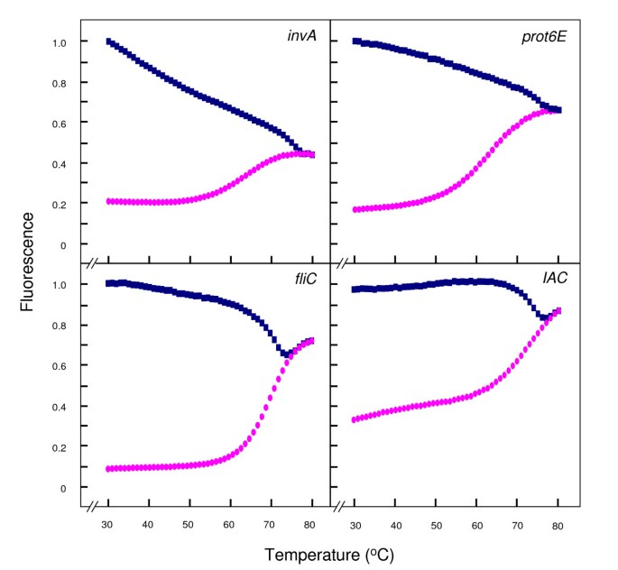
Molecular Beacon Cycle-
Activation step at 95°C for 10 min, followed by 50 cycles, each consisting of 95°C for 15 s, 50°C for 30 s (data collection step) and 72°C for 30 s.
Thermal denaturation profiles of the molecular beacons. Thermal denaturation profiles of the molecular beacons used in this study as established by melting curve analysis (described in Materials and Methods). The figure shows normalised fluoresence thermal transitions of molecular beacon plotted in pink circles and beacon-target complexes plotted in blue squares.
Notes:
https://bmcmicrobiol.biomedcentral.com/articles/10.1186/1471-2180-9-97
A temperature of 50°C was chosen as an optimal annealing temperature for subsequent real-time PCR studies. At this temperature the difference in fluorescence signal between beacon alone and beacon-target hybrids is large; in the absence of target any fluorescence detected is background level and the temperature is high enough to prevent less energetically favourable hybrids from forming, e.g., primer dimers or beacon-primer dimers.
When the molecular beacon binds to the target sequence it is linearized. This separates the quenching group from the fluorophore, which is now free to fluoresce. Care is needed to avoid disrupting the short stem structure. For example, high temperatures will cause unpairing and give a false positive response.

Slide 25
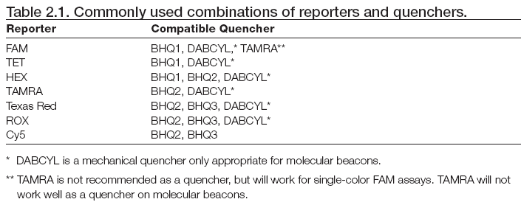

Slide 26
Typical Real-Time PCR cycle
1. 95 C- 10 min
2. 95- 30 sec
3. 60- 30 sec
4. 72-30 sec
5. Read
6. Go to step 2 for 39 more cycles
7. The melt curve protocol follows with 30 seconds at 95°C and then cooling to Anneaing temp (60C) for 30 sec. and then10 seconds each at 0.2°C increments between 60°C and 95°C. Data collection is enabled at each increment of the melt curve.

Slide 27
Notes:
Normalized reporter signal (Rn): This is the emission intensity of the reporter dye divided by the emission intensity of the passive reference dye measured in each cycle.
Passive reference dye: On some real-time PCR instruments, the fluorescent dye ROX serves as an
internal reference for normalization of the fluorescent signal. It allows correction of well-to-well
variation due to pipetting inaccuracies and fluorescence fluctuations. Its presence does not interfere
with real-time PCR assays, since it is not involved in PCR and has an emission spectrum completely
different from fluorescent dyes commonly used for probes.

Slide 28
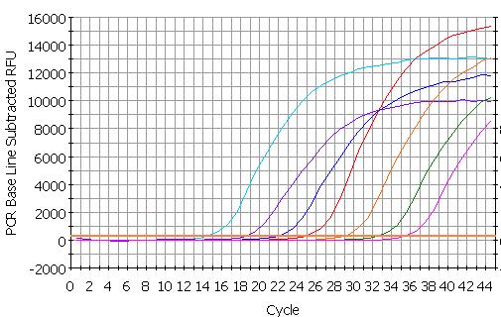
SERIES OF 10-FOLD DILUTIONS
Notes:
So how do we measure differences in concentration of DNA or cDNA? This graph shows a series of 10-fold dilutions of a sample. As one dilutes the sample, it takes more cycles before the amplification is detectable. The blue line here is the same sample we have been following all along. Note that although the reactions show an orderly series of curves in order of dilution as they cross the orange line, if one looks at the upper parts of the curve, they are rather variable. Thus, if we stopped all these reactions at eg 33 cycles and ran a gel, it would indicate that the blue, red and purple reactions had the same amount of amplification, even though the reactions shown by the purple and red lines differ by a factor of 100 in the amount of dna.
Reactions which differed by a factor of 2 would expect to be 1 cycle apart (samples that differ by 10 would be ~3.3 cycles apart).
Is there any way to check that the correct fragments were amplified? One way to do some checking on the products is to do a melting curve.
Back to the kinetics of SYBR green incorporation in our series of 10-fold dilutions. Here is the data on an arithmetic scale.

Slide 29
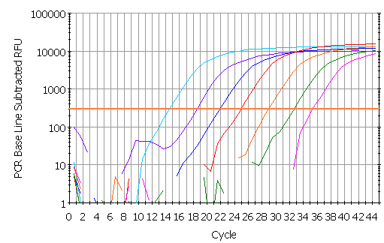
threshold
Ct
The Threshold line is the level of detection or the point at which a reaction reaches a fluorescent intensity above background. The threshold line is set in the exponential phase of the amplification for the most accurate reading. The cycle at which the sample reaches this level is called the Cycle Threshold, Ct.
Notes:
This shows the same data as on the previous slide but on a logarithmic scale. The even spacing of the reactions is now much more obvious. So what the software actually measures for each well is the cycle number at which the fluorescence crosses an arbitrary line called the threshold - shown in orange. This crossing point is known as the Ct value. More dilute samples will cross at later Ct values.

Slide 30
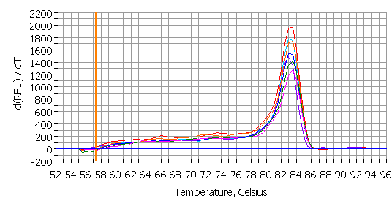
MELTING CURVE
The software plots the rate of change of the relative fluorescence units (RFU) with time (T) (-d(RFU)/dT) on the Y-axis versus the temperature on the X-axis, and this will peak at the melting temperature (Tm).
Notes:
The real-time machine not only monitors DNA synthesis during the PCR, it also determines the melting point of the product at the end of the PCR. The melting temperature of a DNA double helix depends on its base composition (and its length if it is very short). All PCR products for a particular primer pair should have the same melting temperature - unless there is contamination, mispriming¹, primer-dimer² artifacts, or some other problem. Since SYBR green does not distinguish between one DNA and another, an important means of quality control is to check all samples have a similar melting peak. After real time PCR amplification, the machine can be programmed to do a melt curve, in which the temperature is raised by a fraction of a degree and the change in fluorescence is measured. At the melting point, the two strands of DNA will separate and the fluorescence will rapidly decrease. The software plots the rate of change of the relative fluorescence units (RFU) with time (T) (-d(RFU)/dT) on the Y-axis versus the temperature on the X-axis, and this will peak at the melting temperature (Tm). These are the melting curves for samples on the previous slide, a primer-dimer artefact would give a peak with a lower melting temperature (because it is such a short DNA). If the peaks are not similar, this might suggest contamination, mispriming, primer-dimer artefact etc - you want to be sure that the only thing you detect with SYBR green is the thing you want to detect, that is: a specific DNA fragment corresponding to the size predicted from the position of the primers on the cDNA (if you are looking at mRNA) or the genomic DNA, plasmid DNA, etc (according to what your target DNA is).
¹ Mispriming: cDNAs made due to annealing of the primers to complementary, or partially complementary sequences on non-target DNAs.
Primer-dimer artefacts: the primers can sometimes anneal to themselves and create small templates for PCR amplification - these are the so-called primer-dimer artefacts.
Tm, the temperature at which 50% of the base pairs of a DNA duplex are separated

Slide 31
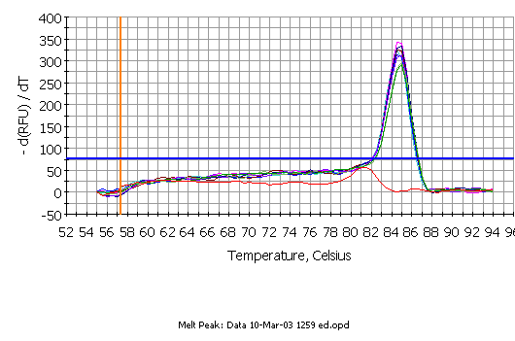
MELTING CURVE
Notes:
In this melting curve all samples were run with the same primer pair, but the sample which contained no DNA (the red line) shows a melting curve with a lower Tm that the other samples. This is due to a primer-dimer artefact. With the SYBR green method, primer-dimer artefacts are a problem since you are measuring total DNA synthesis and need be sure you are measuring a signal that is due to the real target for amplification and not a primer-dimer artefact. Fortunately there are no signs of a primer-dimer artefact in the samples containing DNA in the above graph. However, this does stress the importance of primer design when using SYBR green.

Slide 32
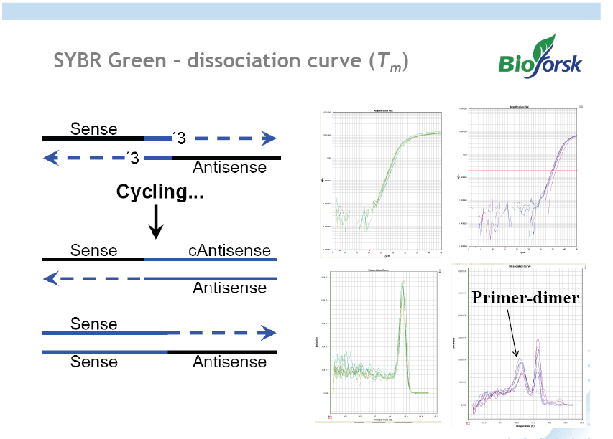
MELTING CURVE

Slide 33
High Resolution Melt (HRM) analysis
High Resolution Melt (HRM) analysis is a powerful technique in molecular biology for the detection of mutations, polymorphisms and epigenetic differences in double-stranded DNA samples. It was discovered and developed by Idaho Technology and the University of Utah. It has advantages over other genotyping technologies, namely:
It is cost-effective vs. other genotyping technologies such as sequencing and TaqMan SNP typing. This makes it ideal for large scale genotyping projects.
It is fast and powerful thus able to accurately genotype many samples rapidly.
It is simple. With a good quality HRM assay, powerful genotyping can be performed by non-geneticists in any laboratory with access to an HRM capable real-time PCR machine.

Slide 34
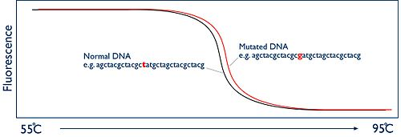
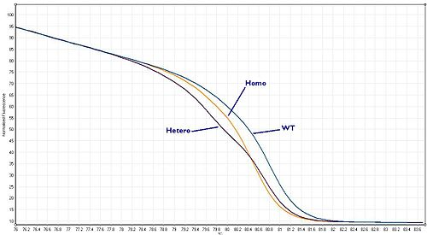

Slide 35
CONTROLS
No template control (NTC): A control reaction that contains all essential components of the amplification reaction except the template. This enables detection of contamination.
RT minus control: RNA preparations may contain residual genomic DNA, which may be detected in real-time PCR if assays are not designed to only detect and amplify RNA.
DNA contamination can be detected by performing a control reaction in which no reverse transcription takes place.
Standard: Sample of known concentration or copy number used to construct a standard curve.

Slide 36
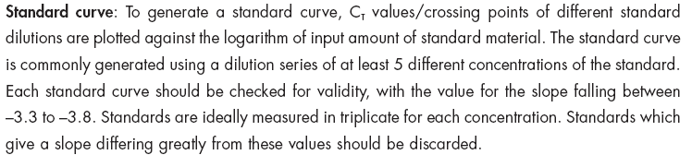
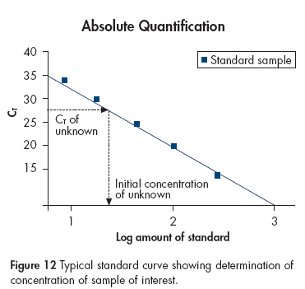

Slide 37
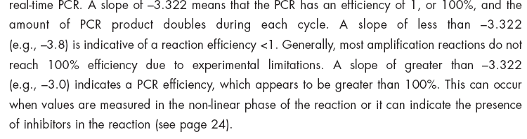
SLOPE AND EFFICIENCY

Slide 38
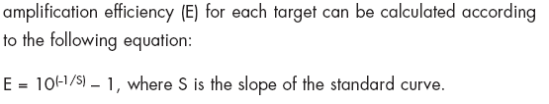
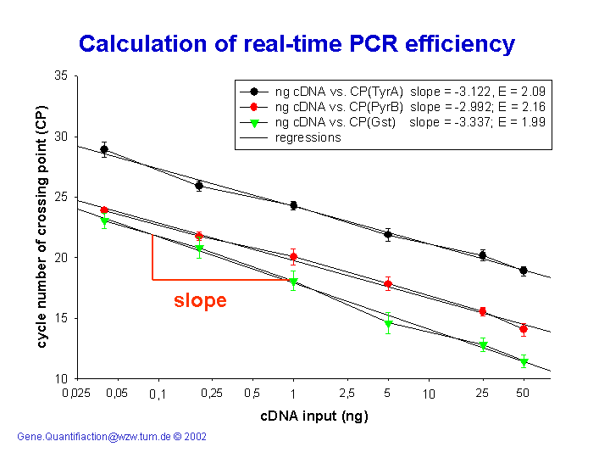

Slide 39
Quantification
Absolute and Relative

Slide 40
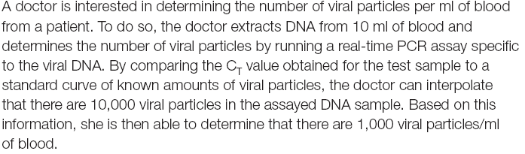
Absolute Quantification

Slide 41
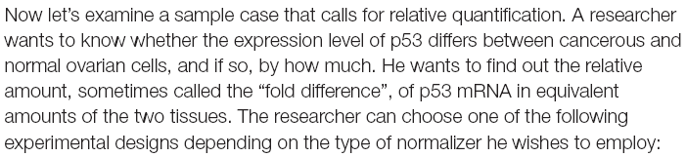
Relative Quantification

Slide 42
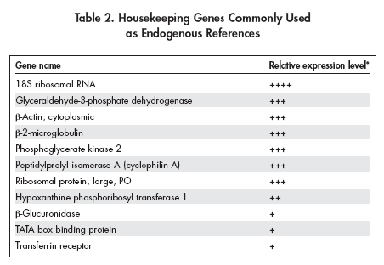
NORMALIZATION CONTROLS

Slide 43

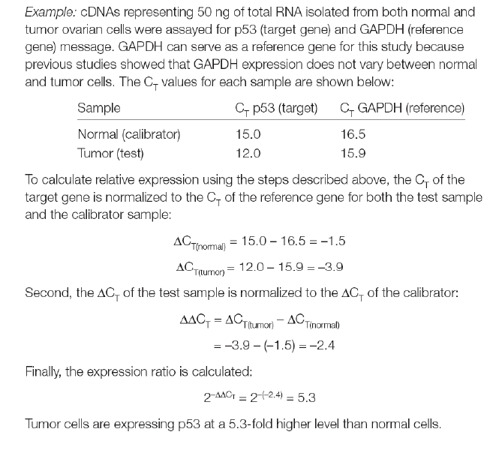
RELATIVE QUANTITATION

Slide 44
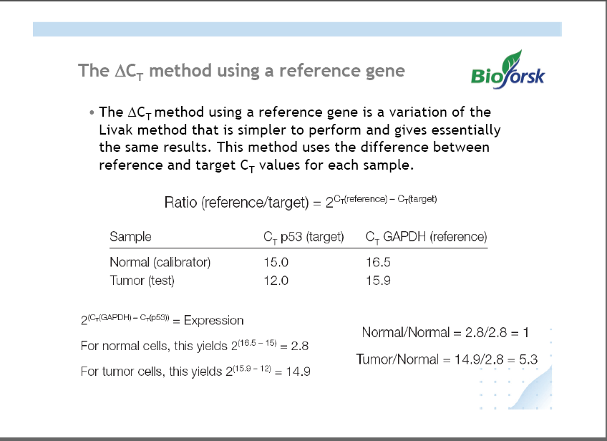

Slide 45
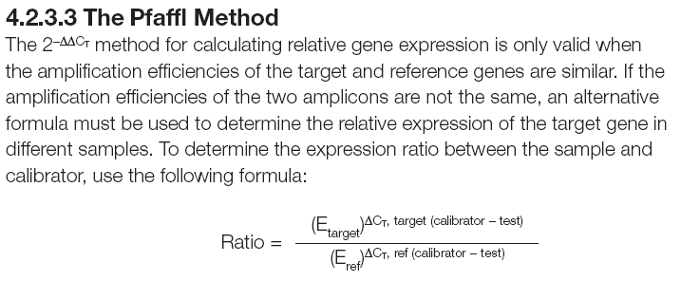

Slide 46
ratio = change in IL1-B = 2053/1.08 = 1901
change in RPLP0
ratio = (E_{target} )^{ΔCt target (control-treated)}
(E_{ref} )^{ΔCt ref (control-treated)}
Notes:
So we derived the change in IL1-beta (left panel) and in RPLP0 (right panel), and we now need to divide the change in target gene by the change in the reference gene as we would do in the
‘Northern equation’ on slide 4.
If we express this in a more general way as is shown in the bottom, we get a universal formula for doing these calculations - this is the formula in Dr. Pfaffl’s paper.

Slide 47
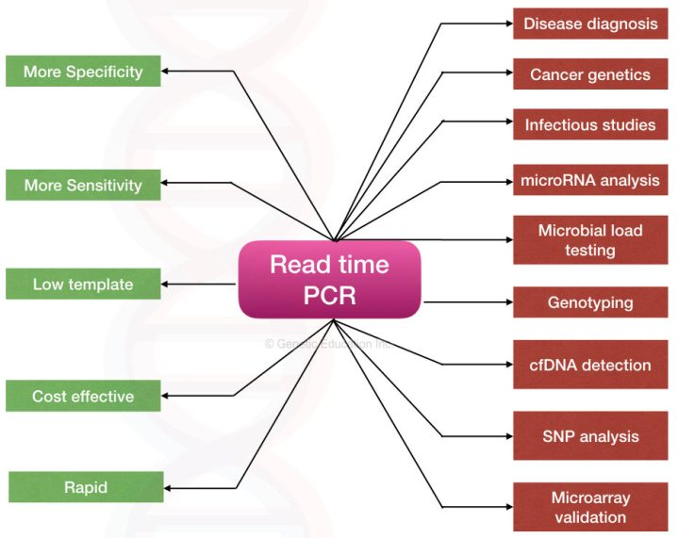

Slide 48
Precautions while setting up RT-PCR
The following precautions can help you avoid contamination problems:
• Wipe down workstations with dilute solutions of bleach or with commercially available decontamination solutions
• Prepare samples in a designated clean room, hood, or benchtop workstation equipped with a UV lamp. Ideally, this should be located in a different area from the thermal cycler. Take care to avoid contaminating the area with plasmids or amplicons; never bring postamplification products into the designated clean area
• Change gloves frequently during sample preparation and reaction setup
• Use shaftguard pipets and aerosol-barrier pipet tips
• Clean pipets frequently with a dilute solution of bleach
• Use PCR-grade water and reagents dedicated for PCR use only
• Use screw-capped tubes for dilutions and reaction setup
Always set up a no-template control and preferably use a hot-star polymerase to prevent amplification before reaction begins.

